Slide 1
IE 6700 DATA MANAGEMENT FOR ANALYTICS Case Study Project Presentation
Done By –
NEEL KAMAL - kamal.ne@northeastern.edu
RAHUL DARUKA - daruka.r@northeastern.edu

Slide 2
Background information:
Parking management is a critical aspect of urban infrastructure. By optimizing the efficient utilization of available parking spaces, an automated parking management system serves to ease congestion and reduce the demand for additional parking infrastructure. Effective parking management not only makes city dwellers' lives more convenient but also helps cut down on emissions and congestion. Real-time availability of parking information, which is frequently provided by mobile applications or digital displays, is convenient for customers. We propose the online "PARKeasy: Parking Management System," which will offer practical and timely solutions to manage parking space, ease traffic, and improve security.
Business Problems:
Inefficient Space Utilization:
One of the most significant problems in parking management is the inefficient use of parking spaces. Many parking facilities struggle to optimize their available spaces, leading to congestion and underutilization issues.
2.Lack of Real-time Information:
Many parking facilities lack real-time information about available parking spaces. This can be frustrating for drivers who spend unnecessary time searching for parking spots, and it can lead to congestion in the vicinity of the parking facility.
Traffic Congestion:
Poorly managed parking can contribute to traffic congestion, especially in urban areas. Vehicles circling in search of parking spots can increase traffic and air pollution.
4.Maintenance and Costs Reduction:
It assists in scheduling maintenance tasks for the parking facility, ensuring that it is safe and well-maintained. Effective management can reduce operational costs, such as manual ticketing and monitoring.
5.Environmental Impact:
Inefficient parking systems can contribute to environmental issues, including increased fuel consumption and emissions due to extended time spent searching for parking.

Slide 3
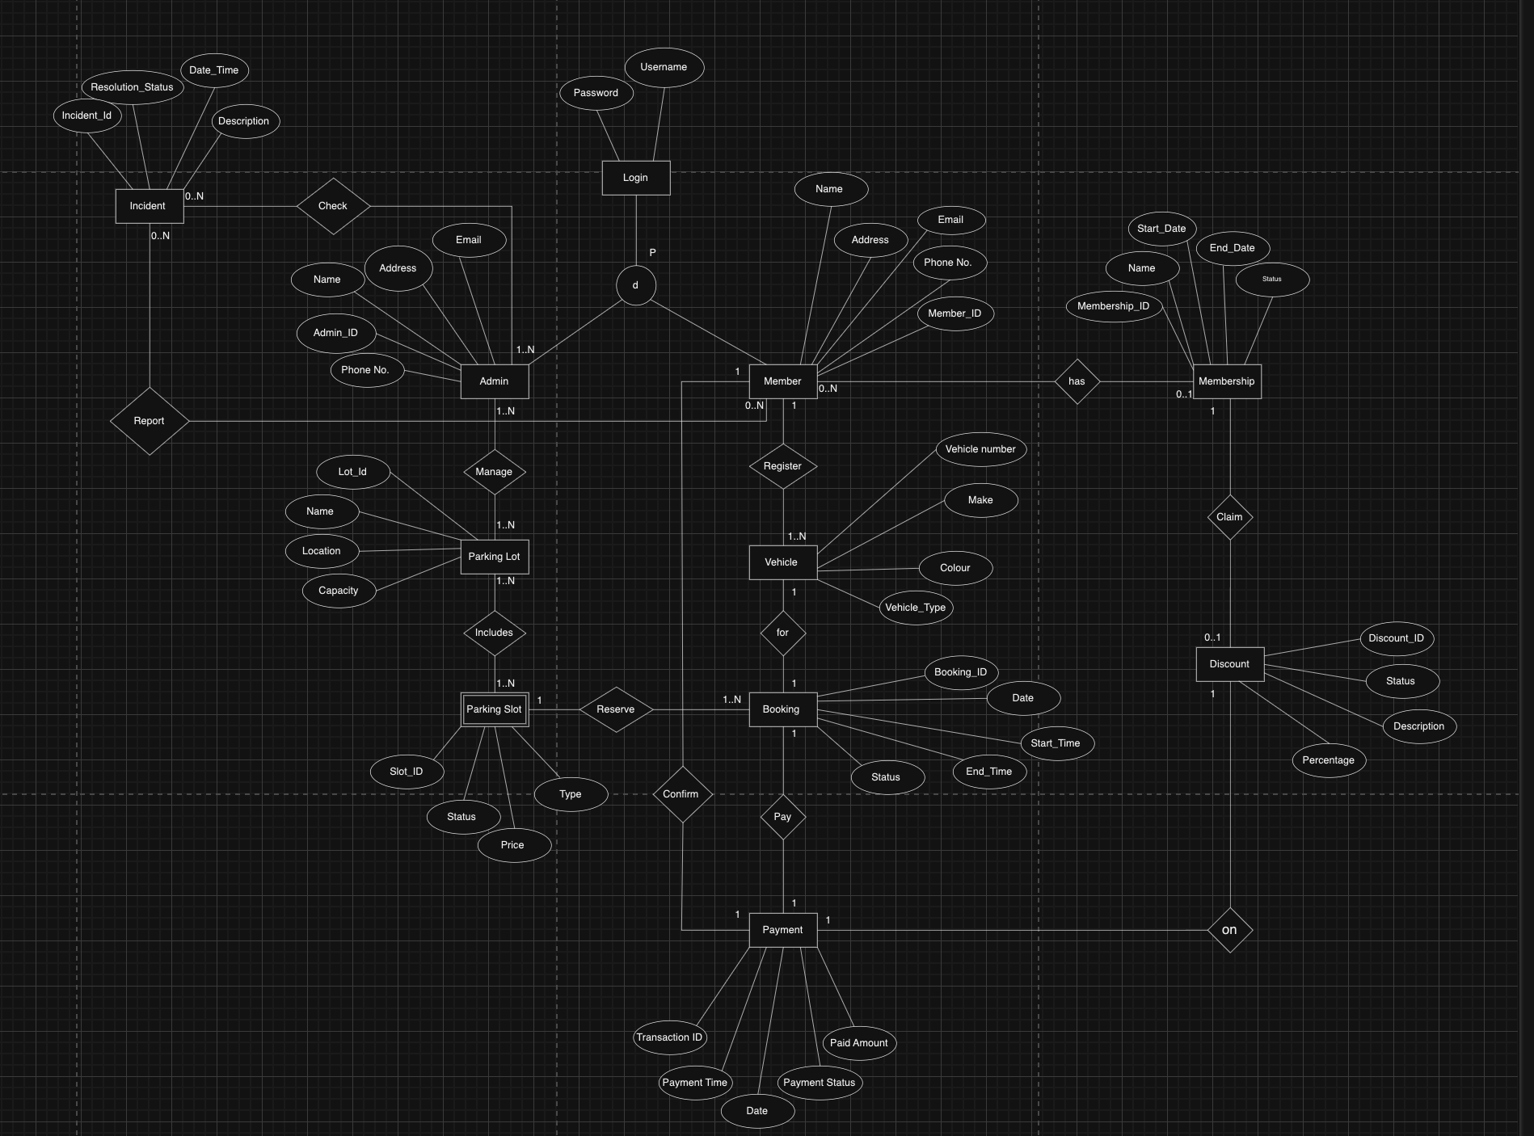
Enhanced Entity Relation(EER) :

Slide 4
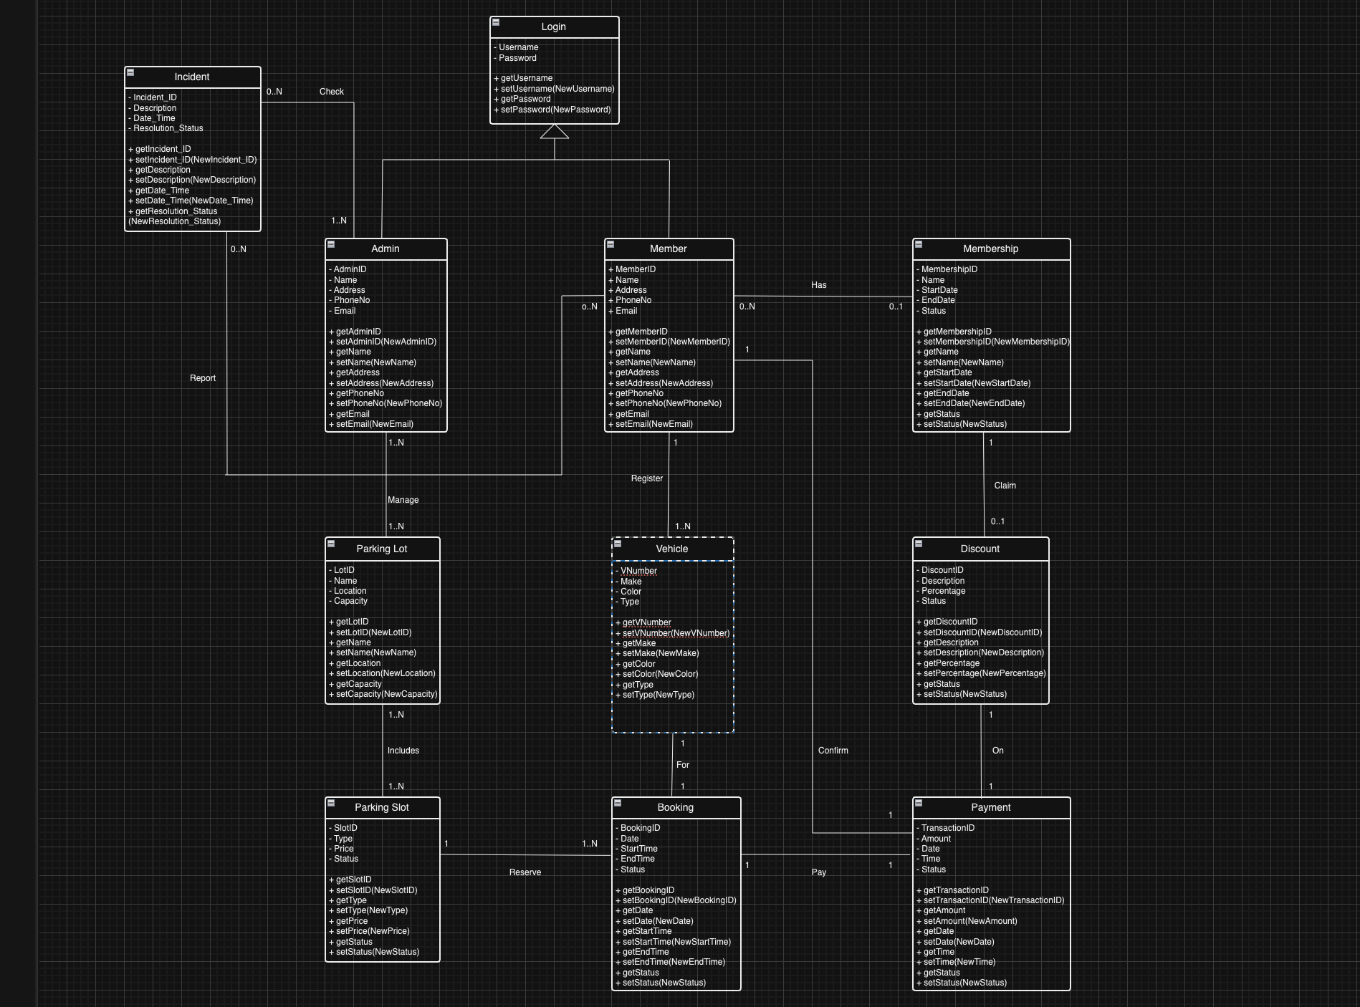
UML :

Slide 5
Logical (Relational) Model
-Admin (AdminID, Name, Address, Email, PhoneNo, Username)
PK: AdminID
FK: Username refers to Login – Not NULL
-ParkingLot (LotID, Name, Location, Capacity)
PK: LotID
-Manage (AdminID, LotID)
FK: AdminID refers to Admin – Not NULL
LotID refers to ParkingLot – Not NULL
-Includes (SlotID, LotID)
FK: SlotID refers to ParkingSlot – Not NULL
LotID refers to ParkingLot – Not NULL
-ParkingSlot (SlotID, Status, Price, Type)
PK: SlotID
-Booking (BookingID, Date, StartTime, EndTime, Status, TransactionID, SlotID)
PK: BookingID
FK: TransactionID refers to Payment – Not NULL
SlotID refers to ParkingSlot – Not NULL
-Report (IncidentID, MemberID)
FK: IncidentID refers to Incident – Not NULL
MemberID refers to Member – Not NULL
-Login (Username, Password)
PK: Username
-Vehicle (VehicleNumber, Make, Color, VehicleType, MemberID, BookingID)
PK: VehicleNumber
FK: MemberID refers to Member – Not NULL
BookingID refers to Booking – Not NULL
-Member (MemberID, PhoneNo, Email, Address, Name, MembershipID, Username)
PK: MemberID
FK: MembershipID refers to Membership – NULL Allowed
Username refers to Login- Not NULL
-Membership (MembershipID, Name, StartDate, EndDate, Status, DiscountID)
PK: MembershipID
FK: DiscountID refers to Discount – NULL Allowed
-Discount (DiscountID, Status, Description, Percentage)
PK: DiscountID
-Payment (TransactionID, Date, Time, PaymentStatus, Amount, MemberID)
PK: TransactionID
FK: MemberID refers to Member – Not NULL
-Incident (IncidentID, ResolutionStatus, Date_Time, Description, MemberID)
PK: IncidentID
FK: MemberID refers to Member – NULL Allowed
-Inspect (IncidentID, AdminID)
FK: IncidentID refers to Incident – Not NULL
AdminID refers to Admin – Not NULL

Slide 6
THANK YOU!!

